Slide 1



Strategic rollout of Anaplan enhancement Presented by: Kranthi Gude

Slide 2
Introduction
Objective: To enhance the HMLR Anaplan platform to support real-time, self-service financial forecasting, risk input, and variance analysis by budget managers while improving overall usability, accuracy, and integration with Oracle.
Business need: Budget managers require fast, accurate access to financial data to update forecasts, assess financial risks, and support decision-making. The current system has limited flexibility for user input and dependency on manual processes, which hinders responsiveness.
Solution scope: This enhancement will streamline data entry, automate Oracle integration, and improve dashboard interactivity. It will empower users to input their forecasts, financial risks, and variance commentary while enabling finance business partners to provide proactive support through enhanced visibility.

Slide 3
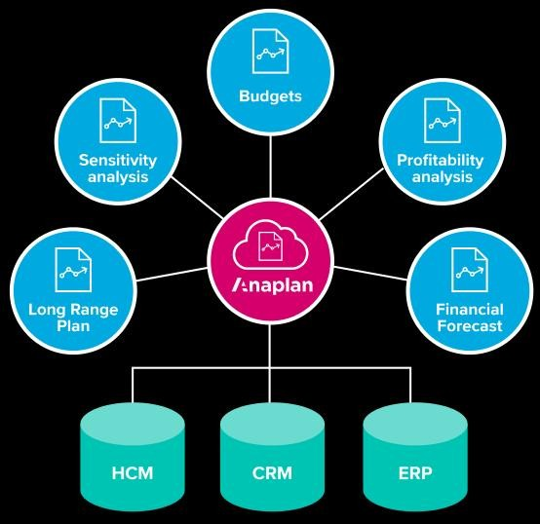
Overview: Anaplan Enhancement Strategy
Streamlined financial data flow and variance processing through integrated Oracle-Anaplan pipelines
Unified forecasting and risk input workflows managed by Budget Managers and supported by Finance Business Partners
Secure and governed planning environment leveraging Anaplan’s role-based access and audit controls
Seamless integration of forecasting, variance analysis, and self-service dashboards into day-to-day operations

Slide 4
User-centric discovery & pain point analysis
Identify Key Users: Budget Managers, Finance Business Partners (FBPs), Finance Leads, and IT Support Teams
1
Run Targeted Workshops & Feedback Sessions: Capture challenges with current forecasting, input interfaces, and Oracle data sync
2
Map Current Workflows & Technical Barriers: Document pain points related to user journeys, manual workarounds, and system latency
3
Prioritize User-Centric Enhancements: Focus on areas such as self-service inputs, real-time dashboarding, and governance controls
4

Slide 5
Implementation phases
Phase 1 – Discovery & Engagement
Run stakeholder workshops and user interviews
Capture functional and technical requirements
Define project scope and enhancement KPIs
Phase 2 – Design & Development
Configure enhancements in Anaplan
Integrate Oracle feeds and improve data mapping
Collaborate with IT for scalability and compliance
Phase 3 – Testing & Validation
Conduct UAT with selected budget managers
Validate input interfaces, data sync, and risk tagging
Refine based on user feedback
Phase 4 – Pilot Rollout
Deploy to 2–3 departments for real-time usage
Provide training and helpdesk support
Monitor adoption and flag early issues
Phase 5 – Full Deployment & Support
Roll out across all finance teams
Launch the training programme with Finance Business Partners
Set up an ongoing support and feedback loop

Slide 6
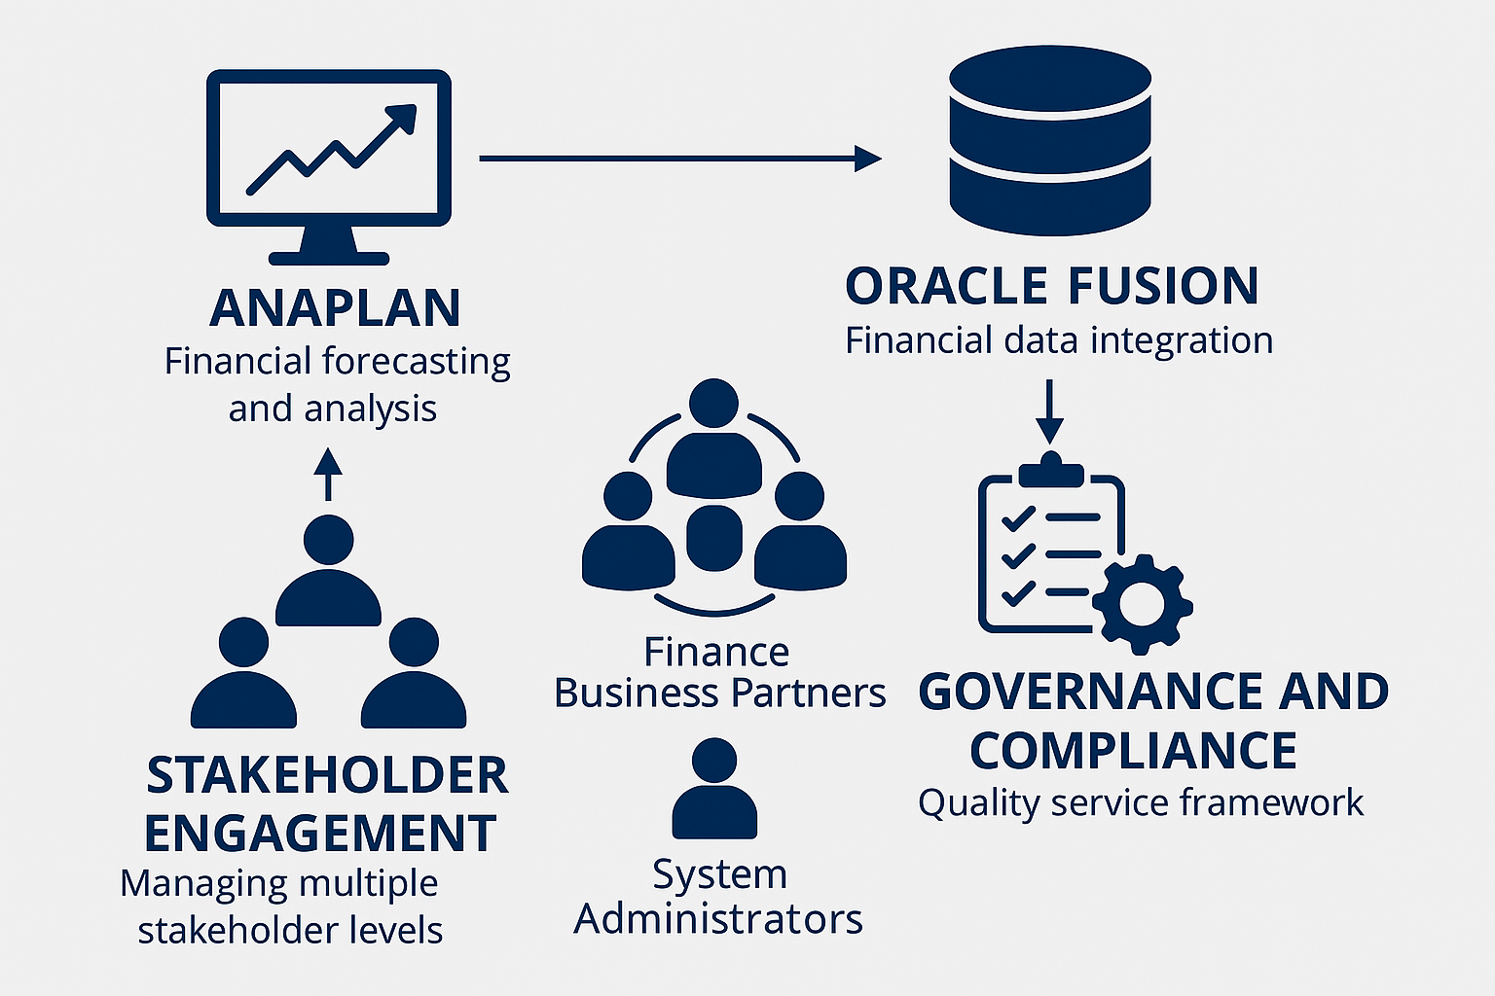
Technical development approach
Agile Sprint Delivery – Fast, iterative development with ongoing feedback
Oracle Integration – Reliable daily actuals flow into Anaplan
Modular Anaplan Design – Forecasts, risks, and variances as flexible components
Data Quality Controls – Validation rules ensure accuracy and auditability
Simplified UI – Clean forms and guided user flows for self-service
Scalable Automation – Low-maintenance, high-efficiency model builds

Slide 7
Self-serve empowerment
Simple forecast input – Easy forms for budget updates
Structured risk tagging – Predefined risk categories
In-dashboard variance commentary – Add notes where variances occur
Real-time validation – Auto-checks for accuracy and completeness
Guided user interface – Tooltips, hints, and progress bars
Audit & revision logs – Track who changed what and when

Slide 8
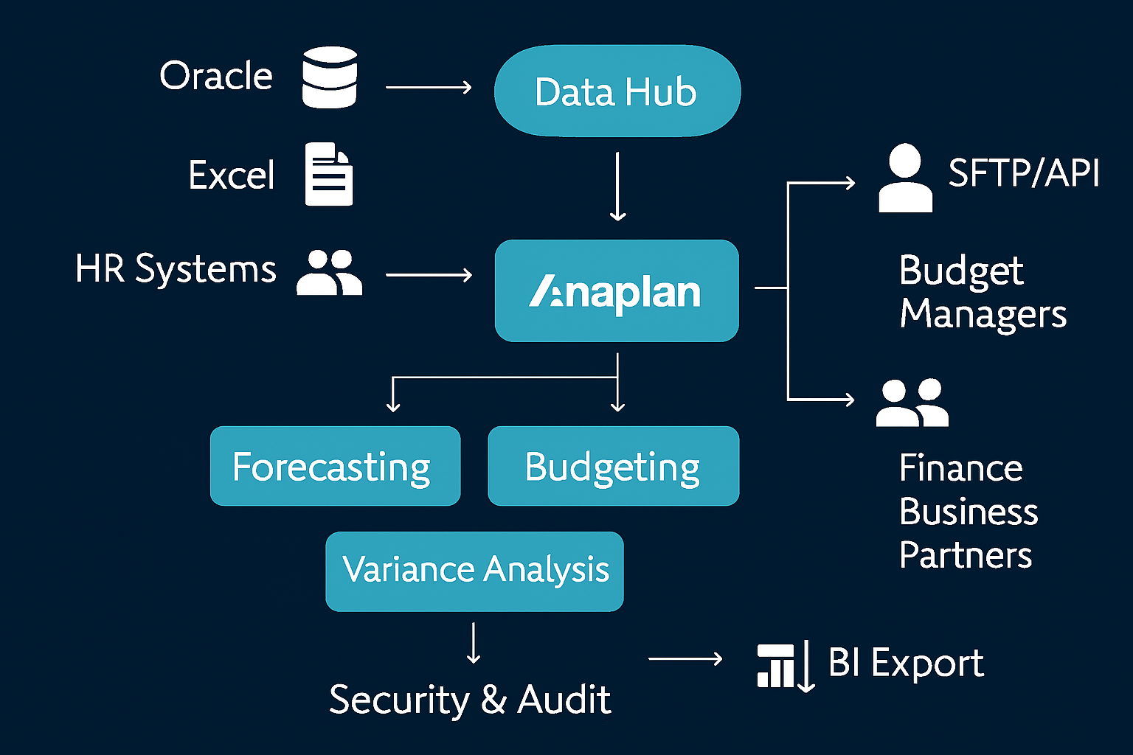
Training and support strategy
Role-Based Training Programmes: Tailored sessions for Budget Managers, Finance BPs, and IT Support covering their respective user journeys.
Blended Learning Materials: Include step-by-step guides, interactive videos, quick reference cards, and tooltips embedded within Anaplan.
Train-the-Trainer Model: Equip Finance Business Partners as local champions to guide and coach end-users within their teams
Phased Onboarding by Department: Coordinate training with pilot and full rollout schedules for targeted adoption.
Drop-In Clinics and Office Hours: Set regular weekly support sessions during rollout to answer questions and resolve issues live.
Knowledge Base and Helpdesk Integration: Create a centralized knowledge hub with FAQs and ticketing linked to the existing support portal.

Slide 9

Managing a quality service
Clear service standards: Define SLAs for data updates, user access, error resolution, and change requests.
Performance monitoring dashboards: Implement monitoring tools to track data freshness, system uptime, and user activity logs.
User feedback loops: Schedule regular feedback surveys and listening sessions to capture user experience and priorities.
Issue resolution & change control: Use a structured support model with triage, escalation, and audit logging for transparency and responsiveness.
Governance & ownership: Assign clear ownership for data quality, model enhancements, and stakeholder communication.
Continuous improvement culture: Review KPIs quarterly and maintain a backlog of enhancement requests to evolve the service iteratively.

Slide 10

Conclusion & Call to action
Phased Implementation Approach: Ensures risk-managed rollout with early feedback, successful pilots, and steady adoption.
Stakeholder-Centric Design: Built around budget managers, FBPs, and real operational needs, driven by feedback and data.
Self-Service Enablement: Empowers users to take ownership of forecasting, risk tracking, and variance commentary.
Sustainable Quality Assurance: Governance, service metrics, and training ensure continuity and performance improvement.
Call to Action:
Approve initiation of Phase 1 (Discovery & Requirements Gathering) Nominate representatives for stakeholder working groups Embed Finance Business Partners in the champion network Support a phased rollout plan and feedback-driven iterations

Slide 11
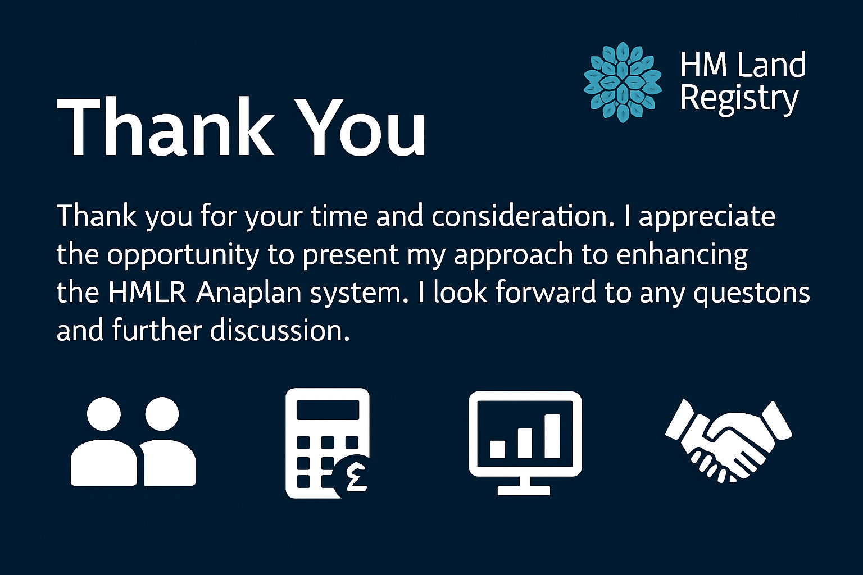
Thank you

